Slide 1

Task 22
Basic and Advanced Data Visualizations with Matplotlib
Name: Basel Amr Barakat
Email: baselamr52@gmail.com

Slide 2
Requirement One
Line and Scatter Plots

Slide 3
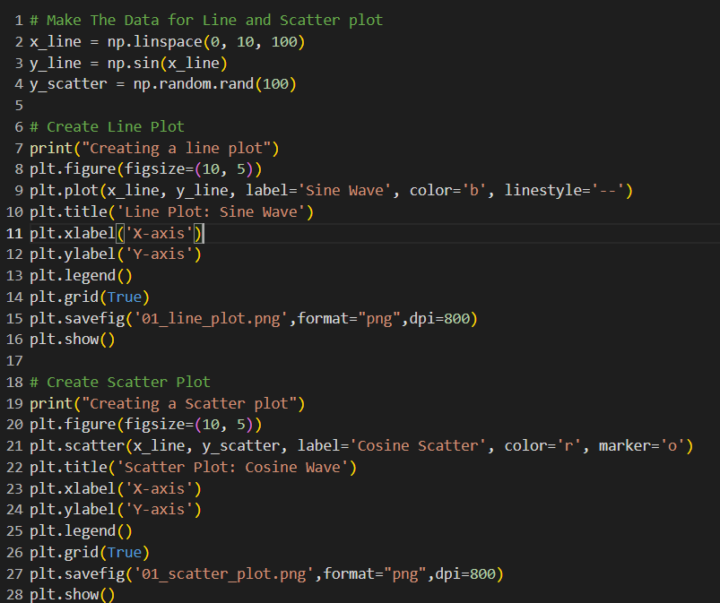
1.1 Plotting a line-plot and Scatter plot Code

Slide 4
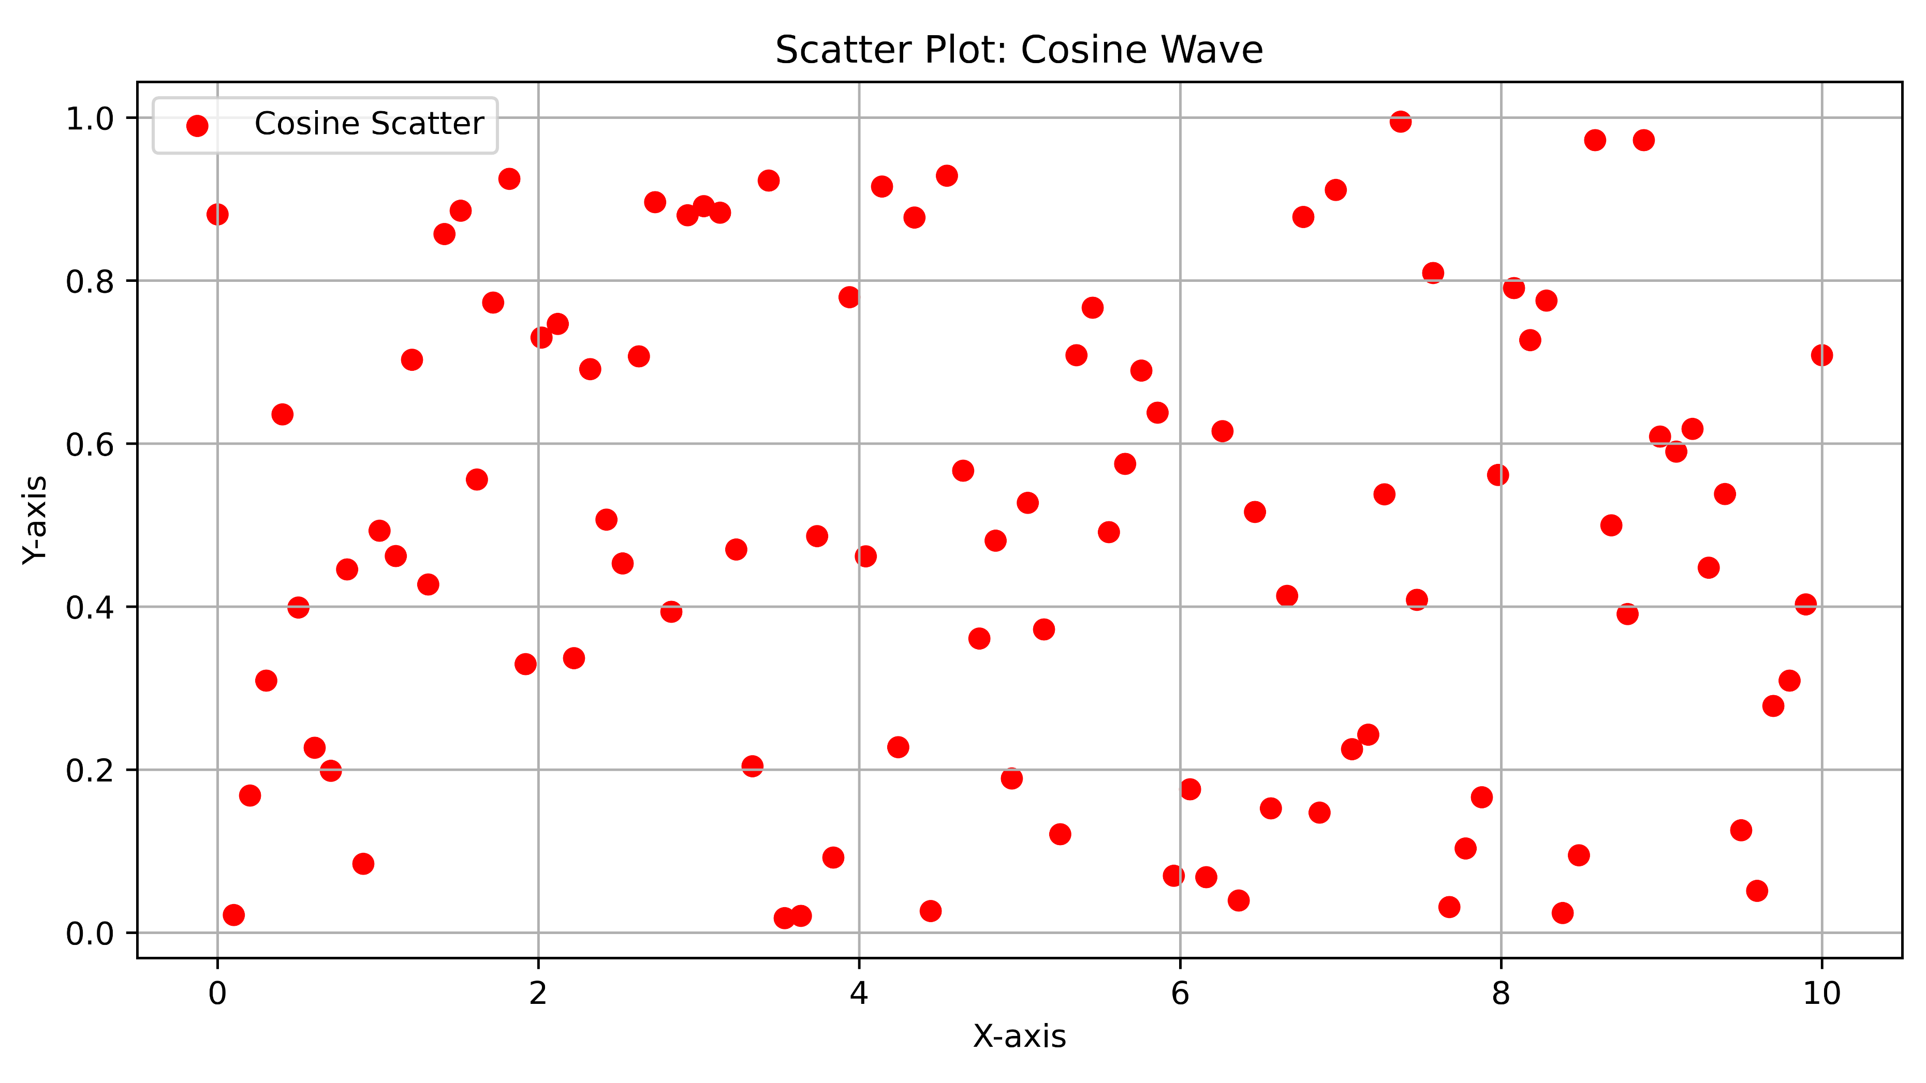
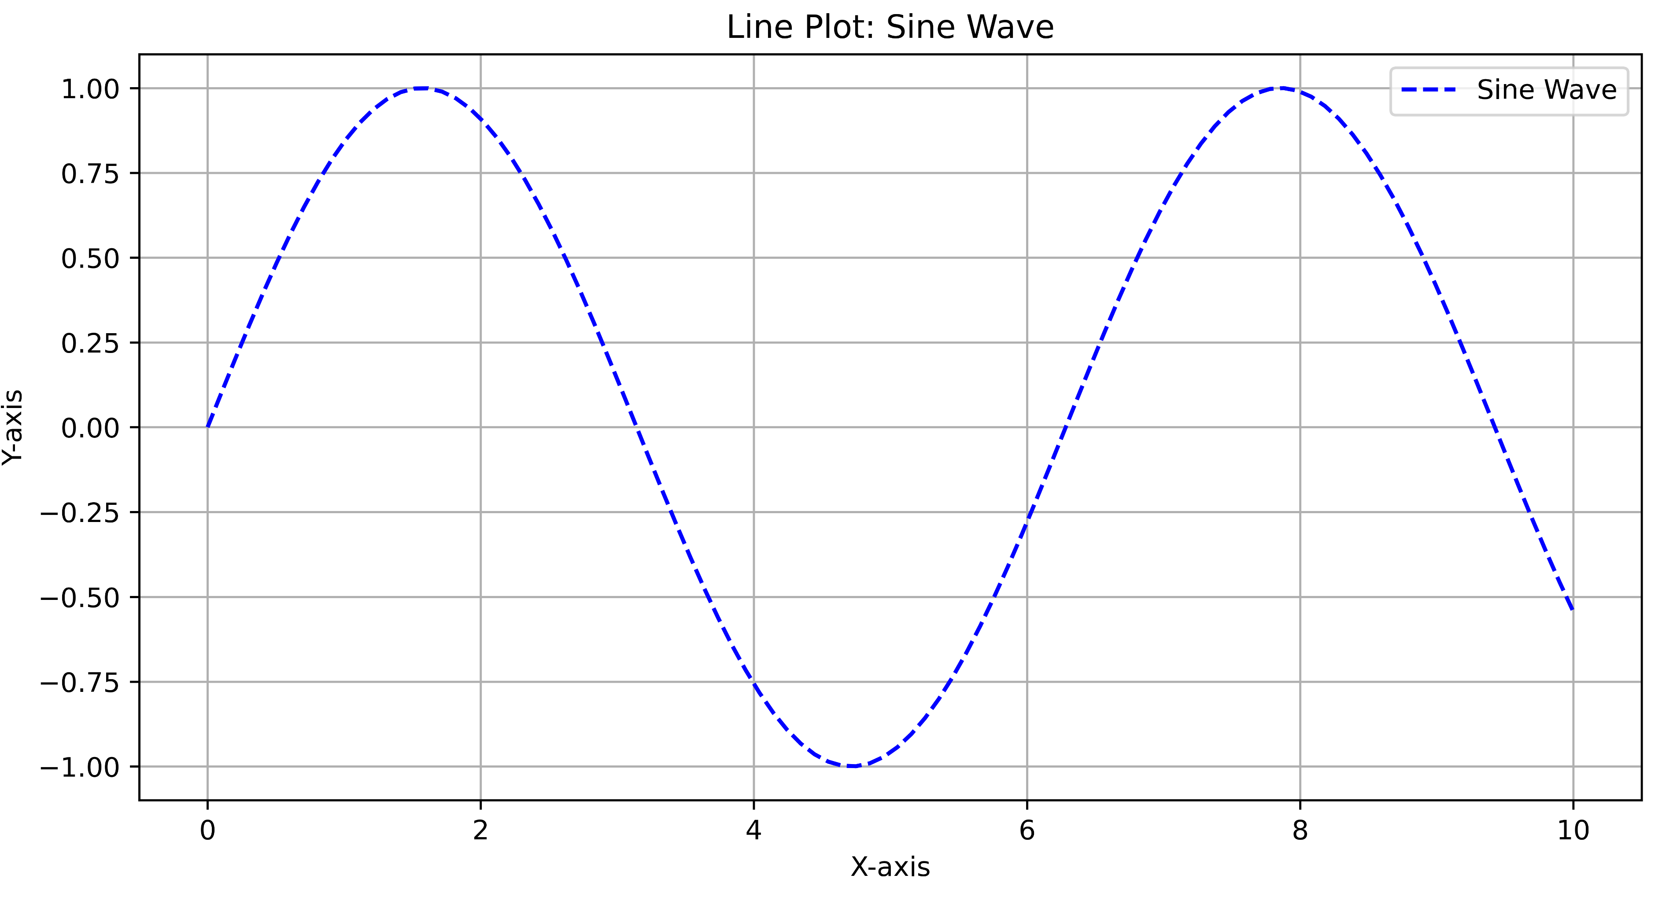
1.1 Plotting a line-plot and Scatter plot Output

Slide 5
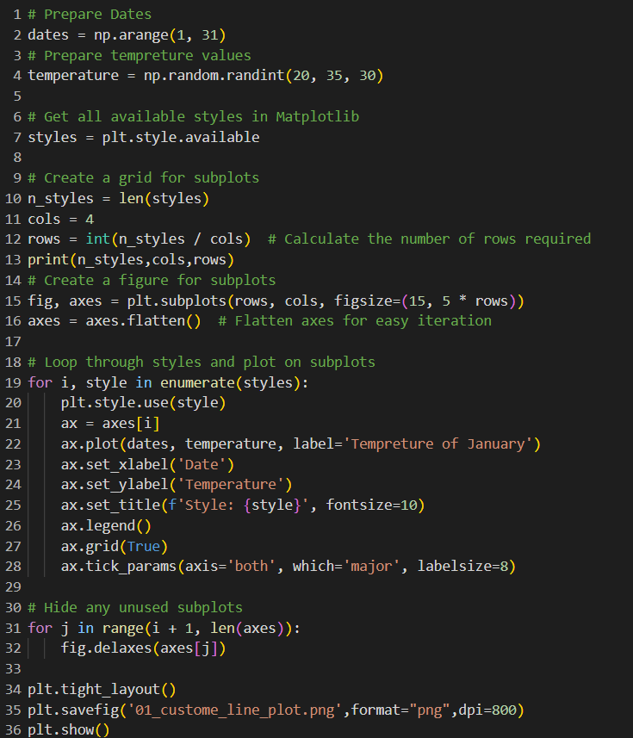
1.2 Custom Line plots code

Slide 6
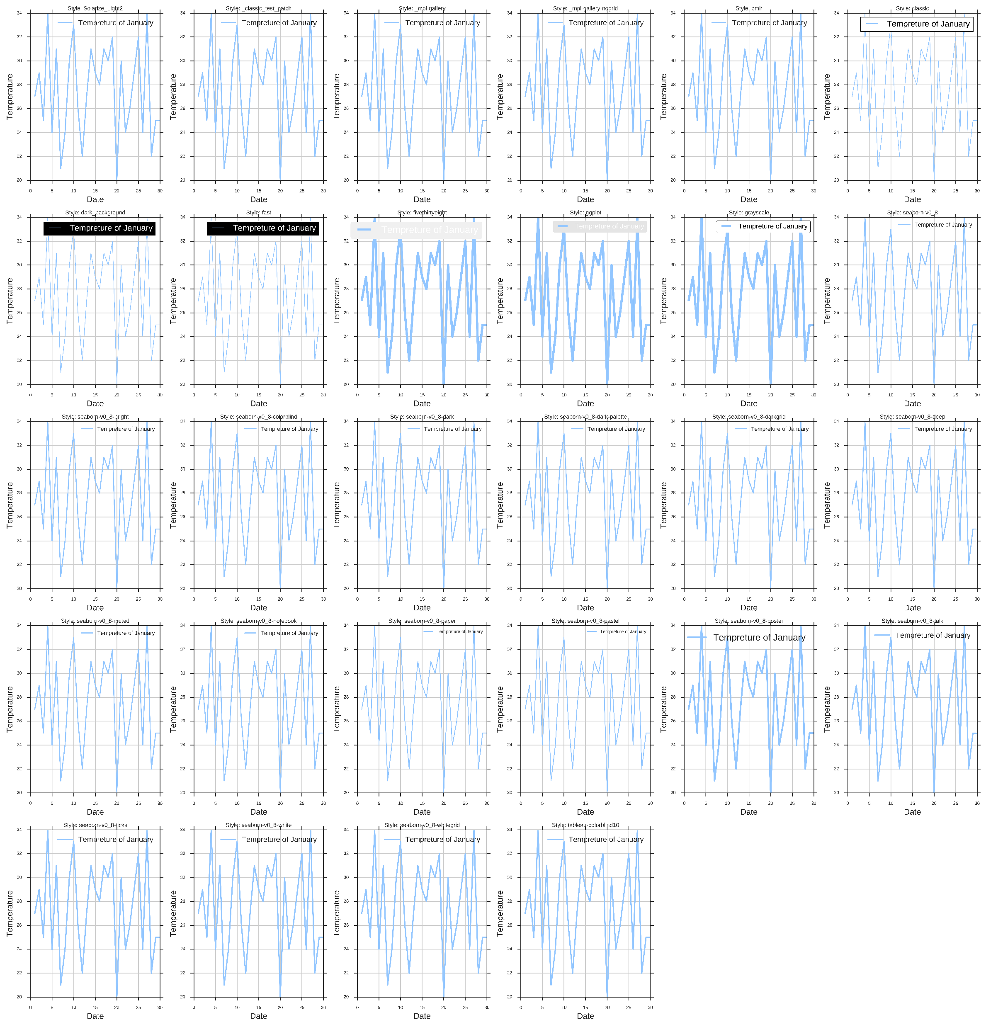
1.2 Custom Line plots Output

Slide 7
Requirement Two
Advanced Plotting with Subplots and Annotations

Slide 8
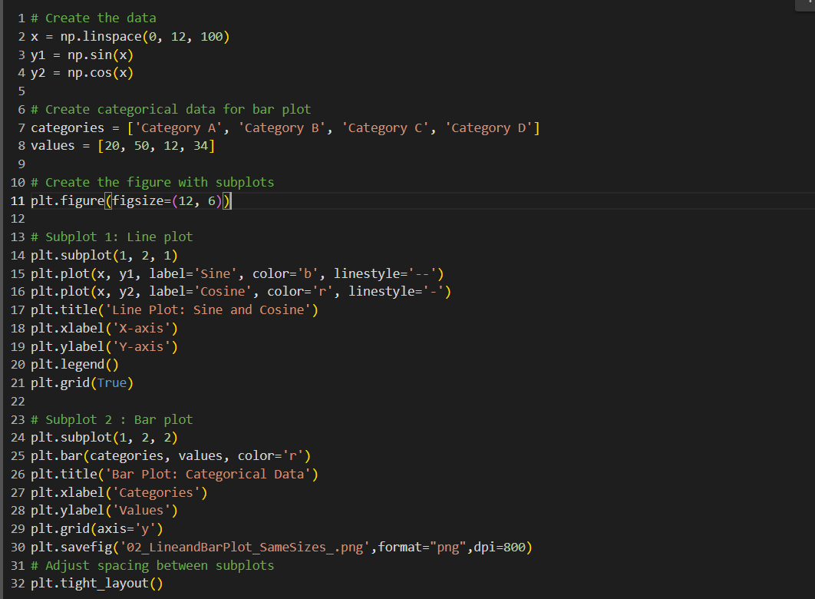
2.2 Creating two subplots with the same size code

Slide 9
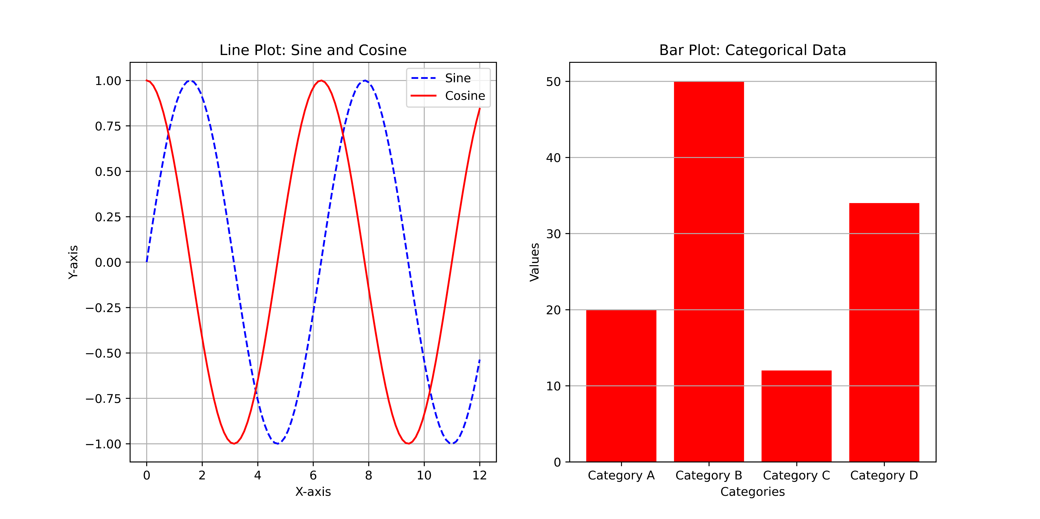
2.2 Creating two subplots with the same size Output

Slide 10
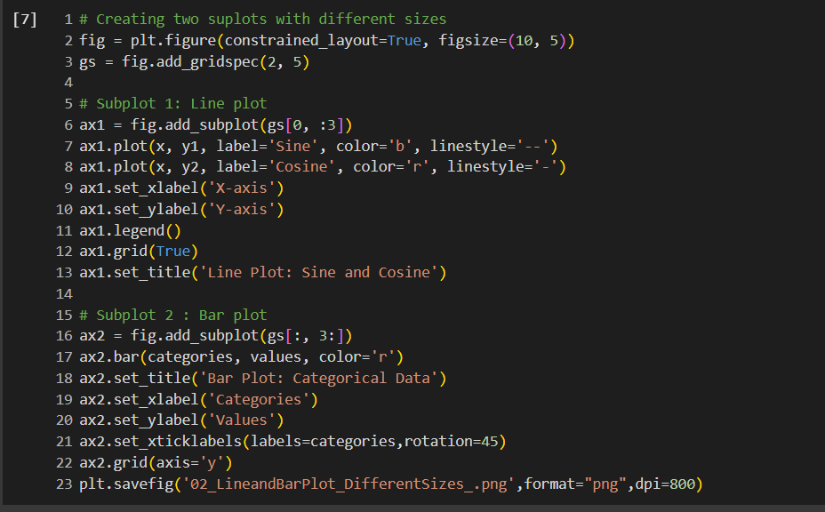
2.2 Creating two subplots with the diff size code

Slide 11
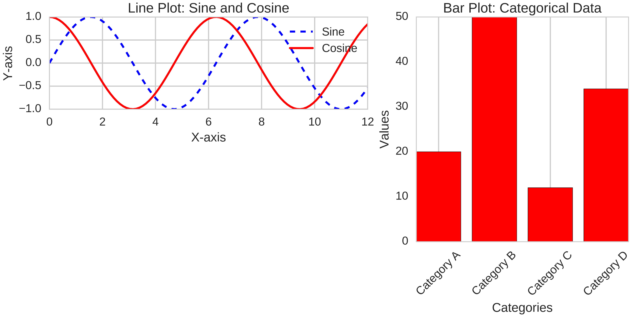
2.2 Creating two subplots with the diff size Output

Slide 12
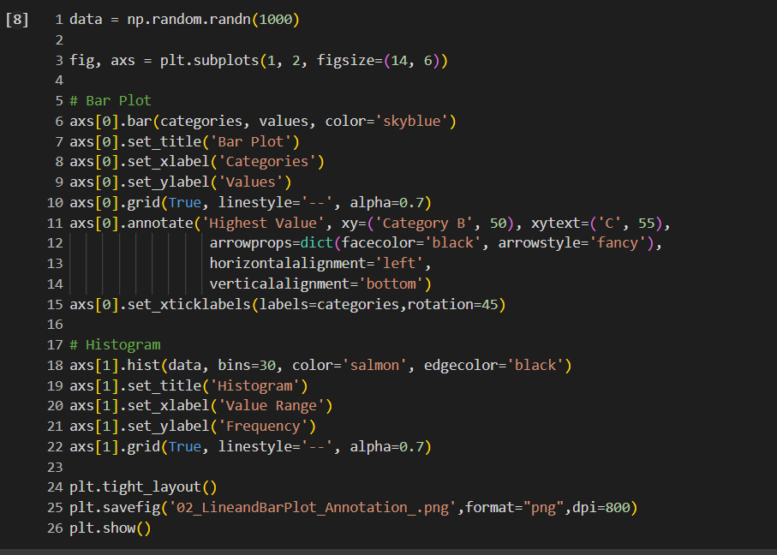
2.3 Creating Bar Plots with annotation Code

Slide 13
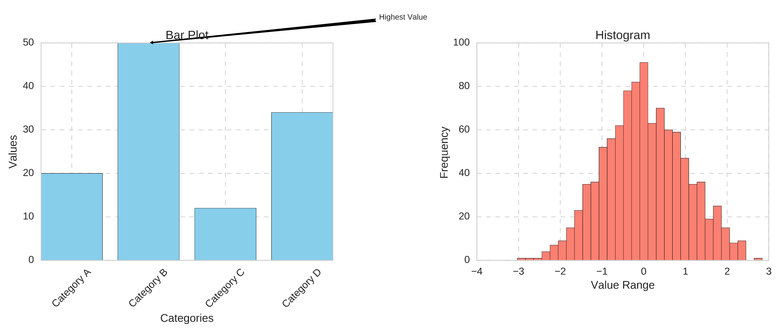
2.3 Creating Bar Plots with annotation Output

Slide 14
Requirement Three
3D Plotting

Slide 15
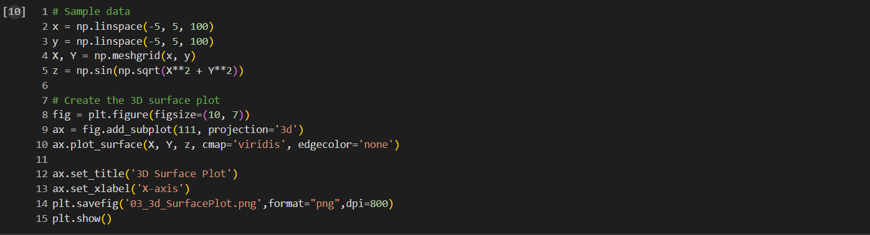
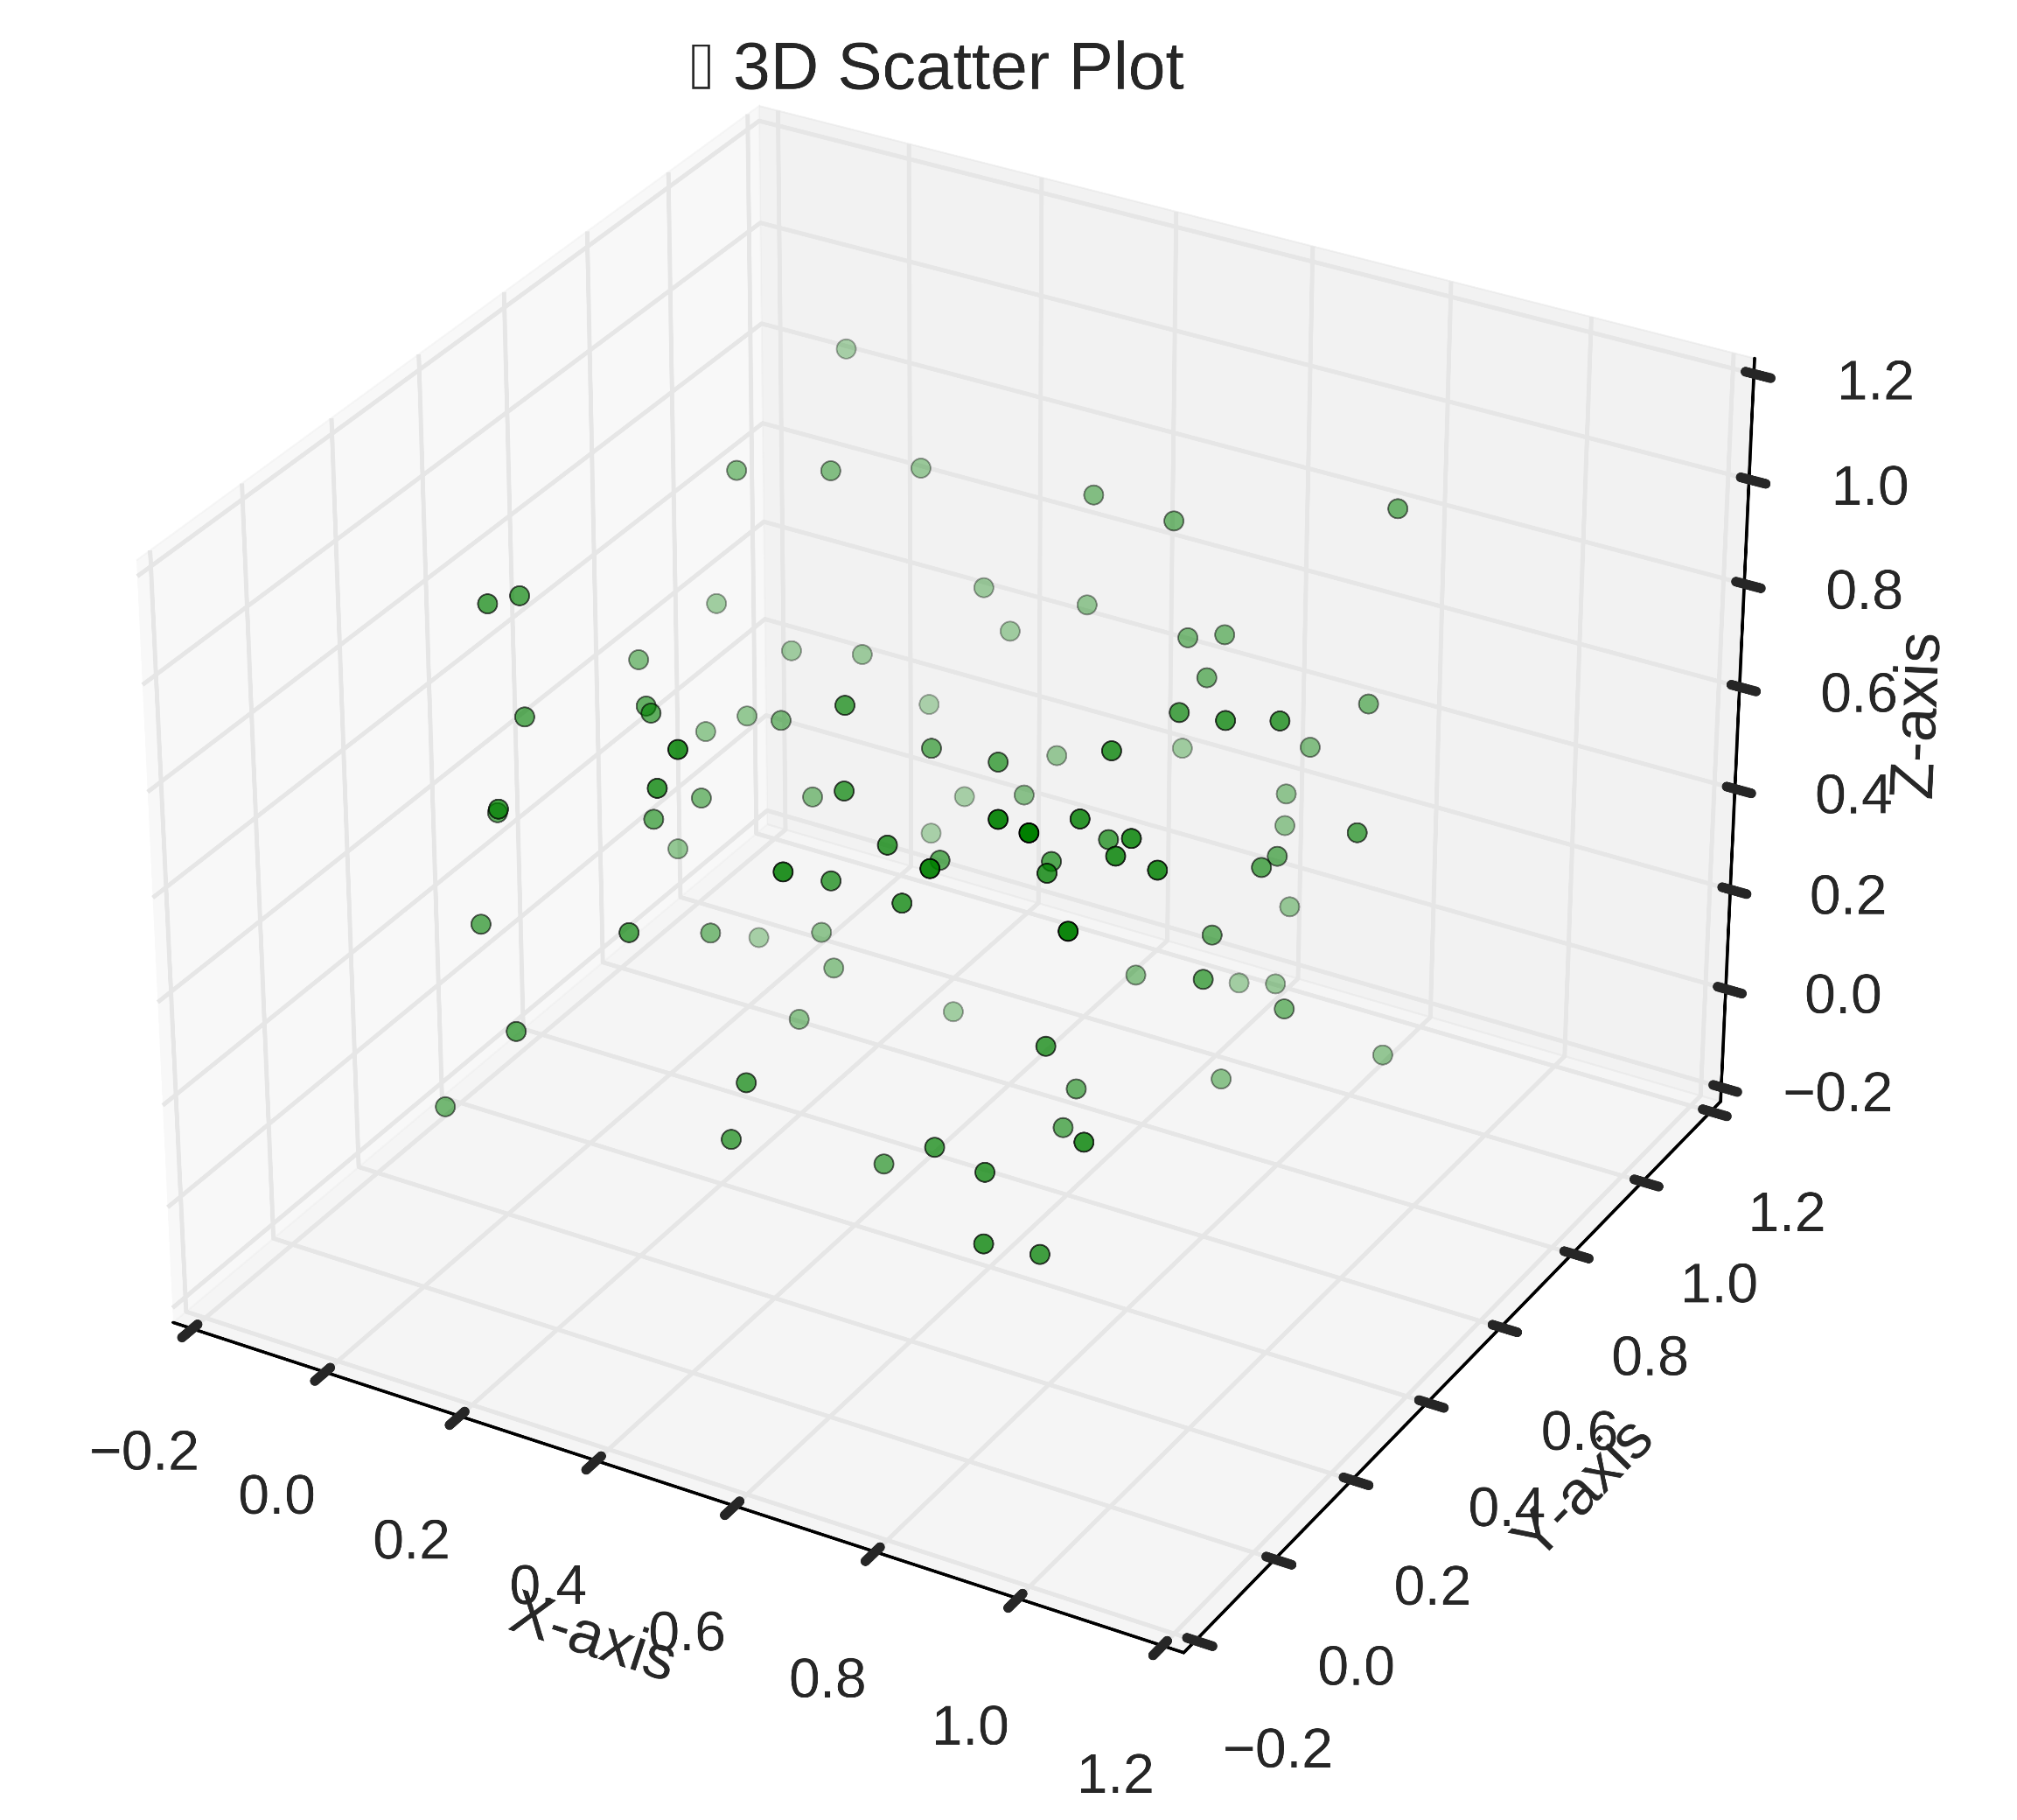
3.1 Scatter Plot

Slide 16
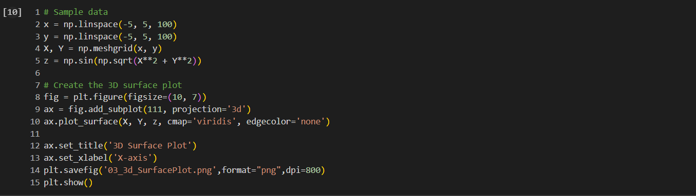
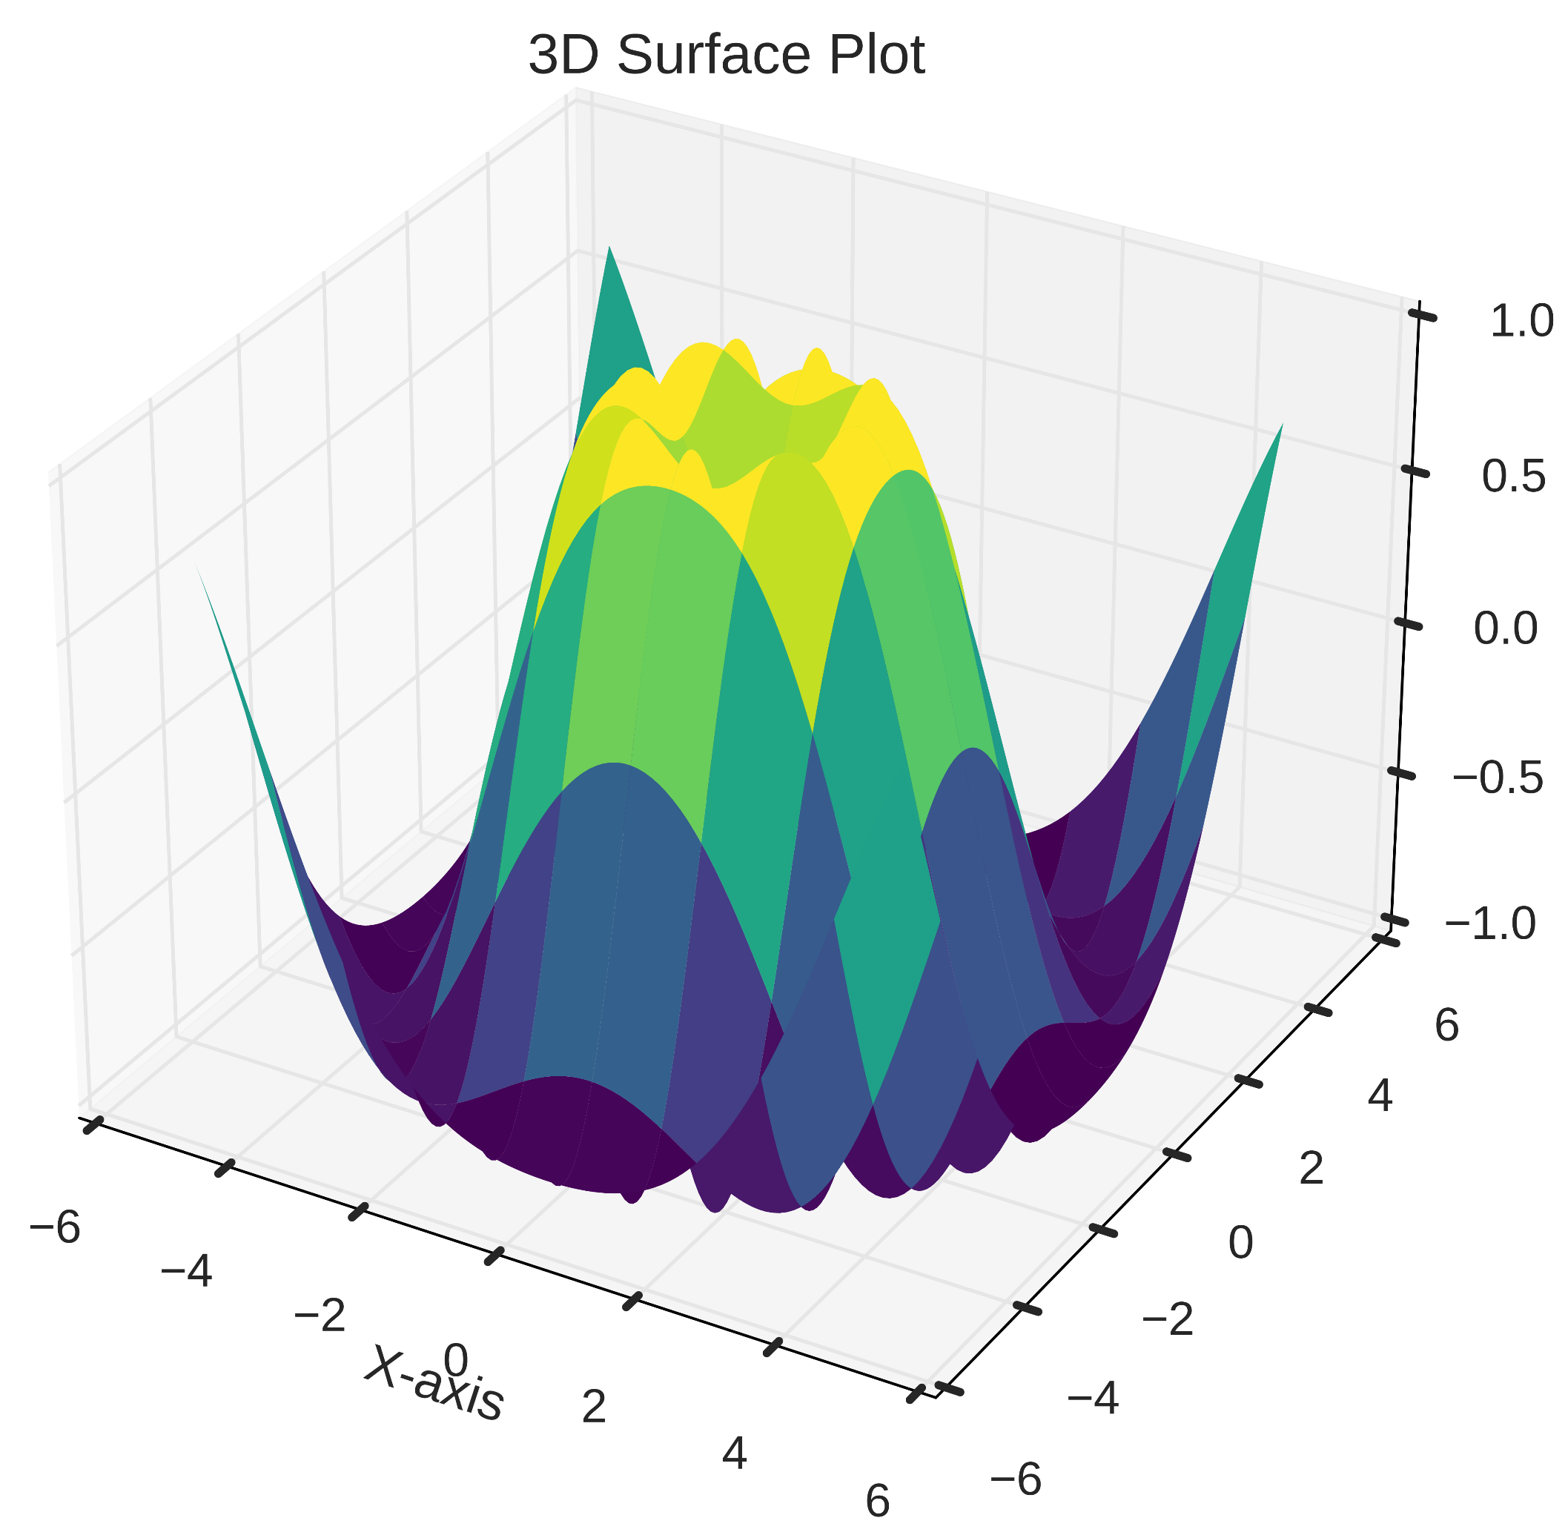
3.2 3D Surface Plot

Slide 17
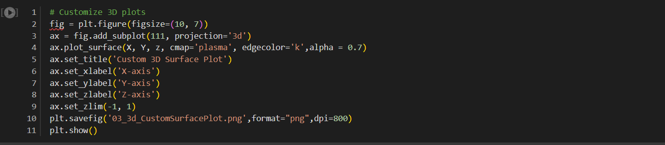
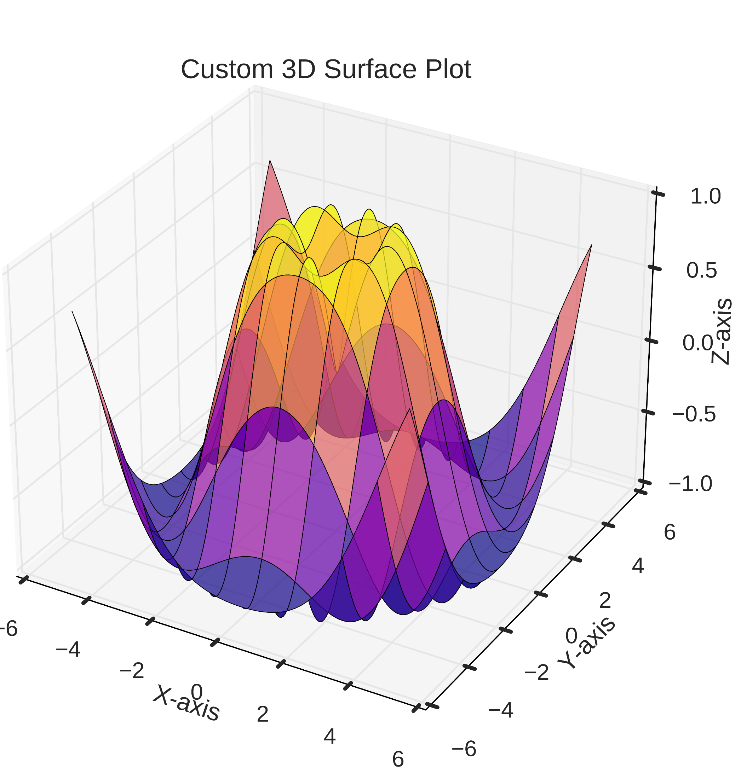
3.3 Customizing 3D Plot

